Slide 1
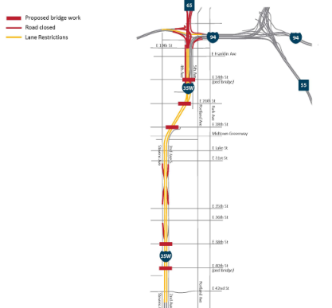
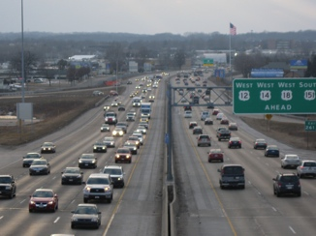
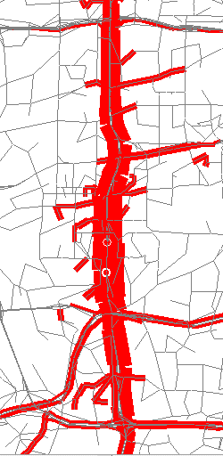
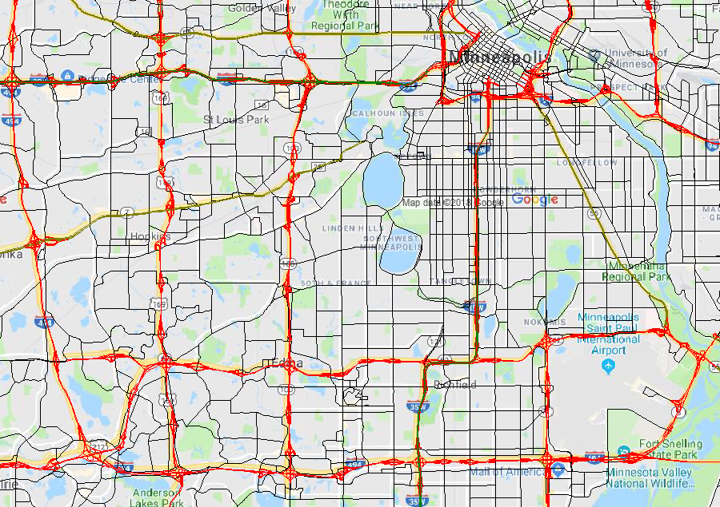
Forecasting Traffic Impacts for Work Zone Transportation Management Plans
TRB Planning Applications Conference
June 4, 2019

Slide 2
Problem Statement
Work zone traffic impacts are addressed through Traffic Management Plans (TMP), a process recently updated to include modeling
Need to validate current modeling capabilities and determine appropriate level of effort

Slide 3
Context
Traditional four-step model recently replaced by activity-based model
DTA updated to spatially align with ABM – larger/more detailed coverage

Slide 4
Approach
Back-casting for two major construction projects
35W@94: Downtown to Crosstown in Minneapolis
US 169 Nine Mile Creek Bridge Replacement
Use of StreetLight Data and MnDOT loop detectors for ground truth data

Slide 5
Slide Symbols
StreetLight Data
Loop Detector Counts
Regional travel demand model (ABM)
Dynamic Traffic Assignment (DTA) model
Street
Light
LOOP
ABM
DTA

Slide 6
35W@94: Crosstown to Downtown

Slide 7
35W@94: Downtown to Crosstown
I-35W from I-94 to 43rd St
Summer 2017 to Fall 2021
Partnership
MnDOT
Metro Transit
Hennepin County
City of Minneapolis
Major transit corridor
Over 500 daily bus trips
14,000 daily rides
Notes:
Aging Infrastructure
Roadway and Bridges originally constructed in 1965.
Replace 11 bridges with 17 new bridges and re-habilitate 4 other bridges.
New Pavement on I-35W from 43rd Street to 11th Avenue
325,000 Square yards of concrete pavement (65 football fields)
70,000 Tons of Asphalt (= to the weight of 35,000 cars)
10 Million pounds of reinforcement (Equal to the weight of 22 Statues of Liberty)
Rehabilitating inplace noise walls
Transit Advantage
Convert Priced Dynamic Shoulder Lane to Permanent MnPASS Lane NB
Establish MnPass Lane in the SB direction out of Downtown Minneapolis
Construct In-Line Transit Station at Lake Street.
Construct direct connection for transit vehicles from TH 65 to 12th Street.
Transit improvements on Lake Street.
Improve Mobility on I-35W and I-94
New access ramps and auxiliary lanes reduce weaving on the corridor
Re-alignment of NB to WB flyover improves mobility on both I-35W and I-94.
Accessibility Improvements
New ramp from NB I-35W to 28th Street. (Improved access to Children’s Hospital, Allina, and Wells Fargo.
New ramp from SB I-35W to Lake Street.
Upgrade intersections to be ADA compliant
Provide infrastructure for bicycle corridors.

Slide 8
I-35W: Construction Scenarios
Alt. | Phase | Description | Number of General Purpose Lanes | Number of Transit/HOV/ MnPass Lanes | TH 65 Ramp Open or Closed | EB I-94 to SB 35W Ramp Open or Closed | NB I-35W to WB I-94 Ramp Open or Closed | Duration
1 | 1 | 6 Lanes | 4 (2 NB / 2 SB) | 2 (1 NB / 1 SB) | Open | Open | Open | 2 Years
 | 2 | 6 Lanes | 4 (2 NB / 2 SB) | 2 (1 NB / 1 SB) | Open | Open | Closed | 2 Years
2a | 1 | 5 Lanes, Phase 1 | 4 (2 NB / 2 SB) | 1 (1 NB / 0 SB) | Closed | Closed | Open | 1 Year
 | 2 | 5 Lanes, Phase 2 | 4 (2 NB / 2 SB) | 1 (1 NB / 0 SB) | Open | Open | Open | 1.5 Years
2b | 1 | 4 Lanes | 4 (2 NB / 2 SB) | 0 | Closed | Closed | Closed | 1 Year
 | 2 | 6 Lanes | 4 (2 NB / 2 SB) | 2 (1 NB / 1 SB) | Open | Open | Closed | 1.5 Years
3 |  | Full Closure | 0 | 0 | Closed | Closed | Closed | 2.5 Years
Timeline
Pre-construction period: April 2018
Construction time period: October

Slide 9
35W ABM: Volume Delta map
ABM
Closed: TH 65 to Downtown and I-94 West
I-35W Capacity Restrictions
Blue – Volume Increase
Orange – Volume Decrease

Slide 10
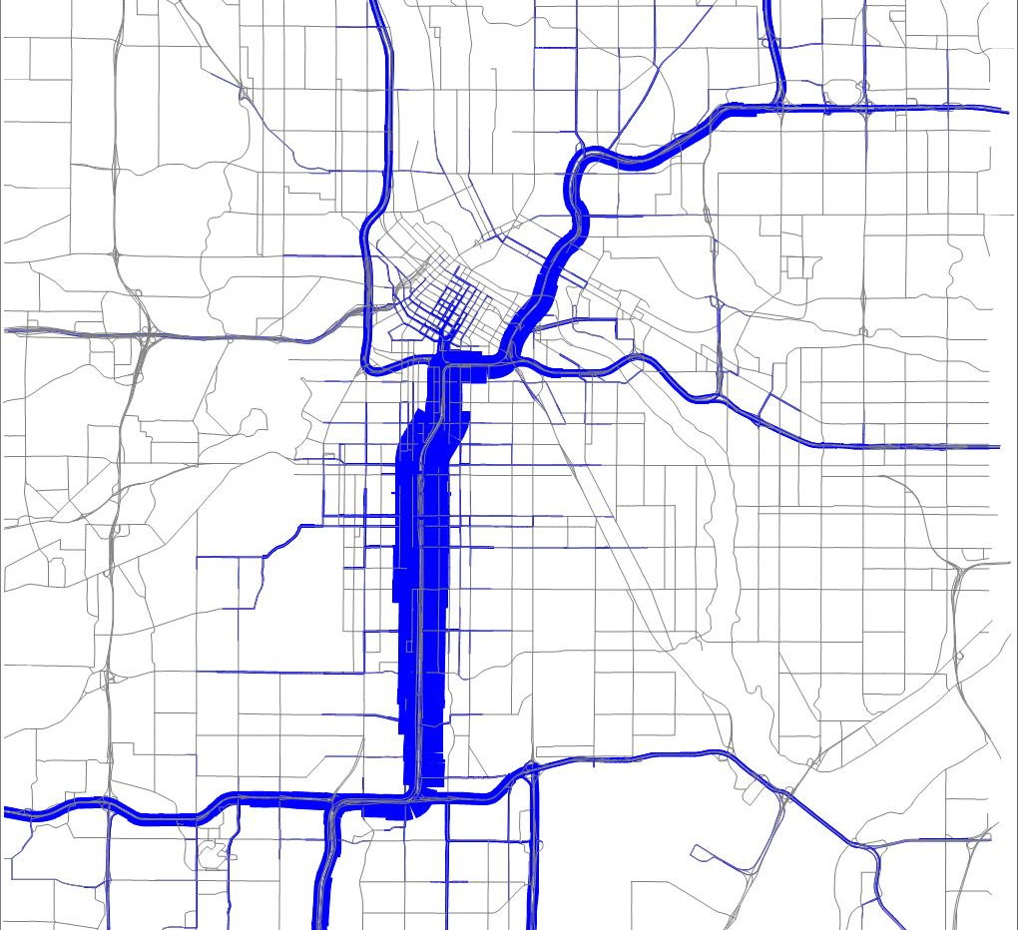
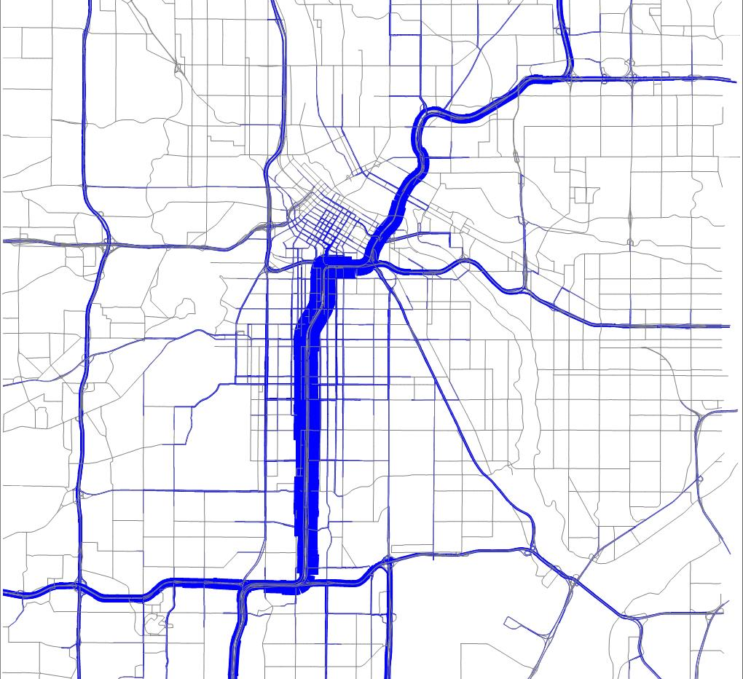
Where does the traffic go?
ABM
Baseline I-35W traffic
Trips assigned with construction restrictions

Slide 11
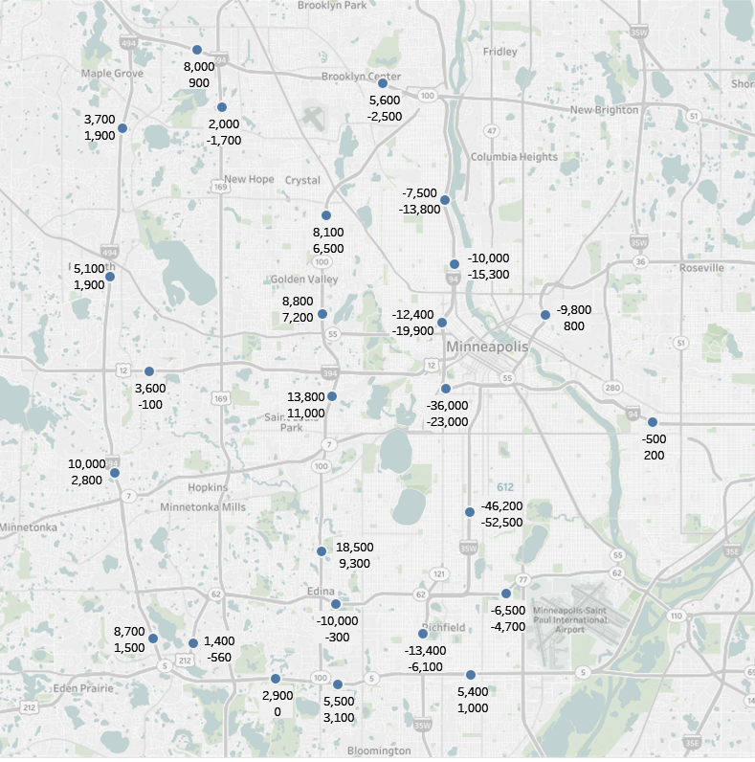
Volume Delta : Freeways
ABM
Many locations have similar traffic diversion pattern (I-35W, I-94, TH 100)
Magnitude of delta in work zone location similar to observed conditions
Loop Detector
ABM

Slide 12
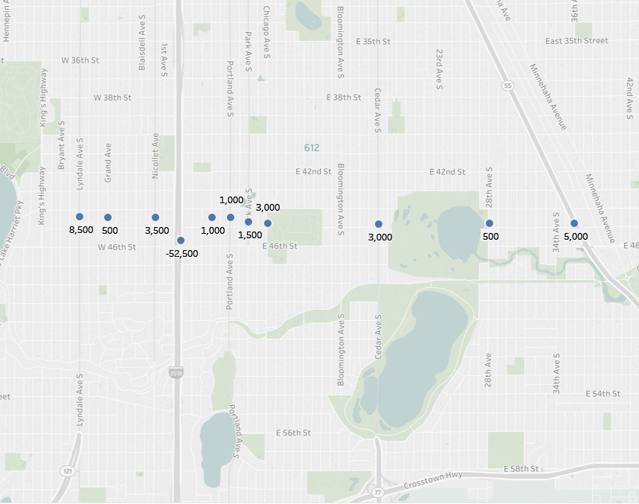
Volume Delta : Arterials
ABM
Lower volume diversion on arterials versus DTA
27,500 Volume delta on arterials
About 50% of diversion within 2.5 miles of I-35W
Volume Delta

Slide 13
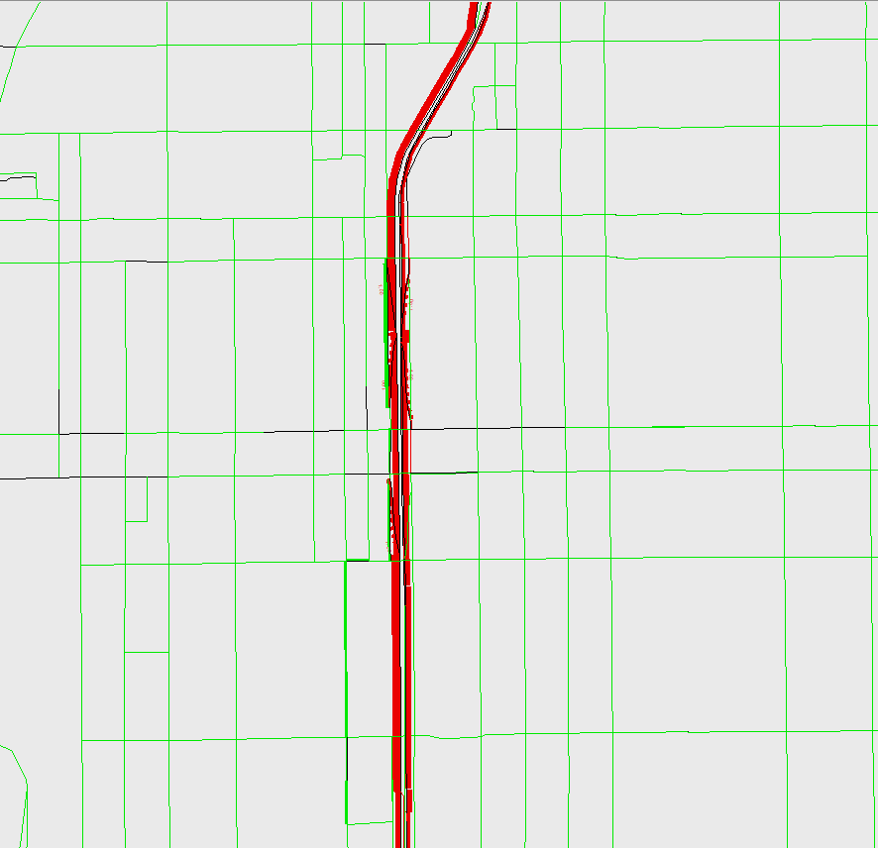
DTA: Local Streets
DTA
High volume diversion on Stevens Ave
Volume Delta at:
Stevens Ave: +26,000
Nicollet Ave: +12,000

Slide 14
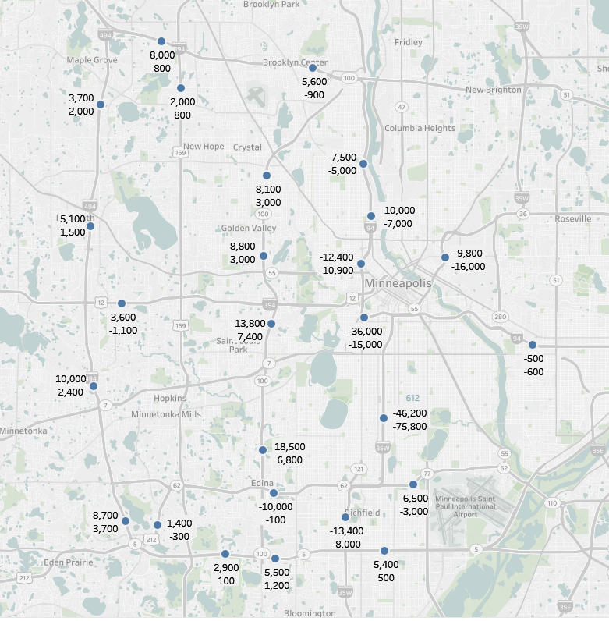
Volume Delta : Freeways
LOOP
DTA
31 Locations
Overestimation of volume delta at the work zone location
Underestimation of volume delta on freeway system
Possible chances of overestimation on lower functional class
Loop Detector
DTA

Slide 15
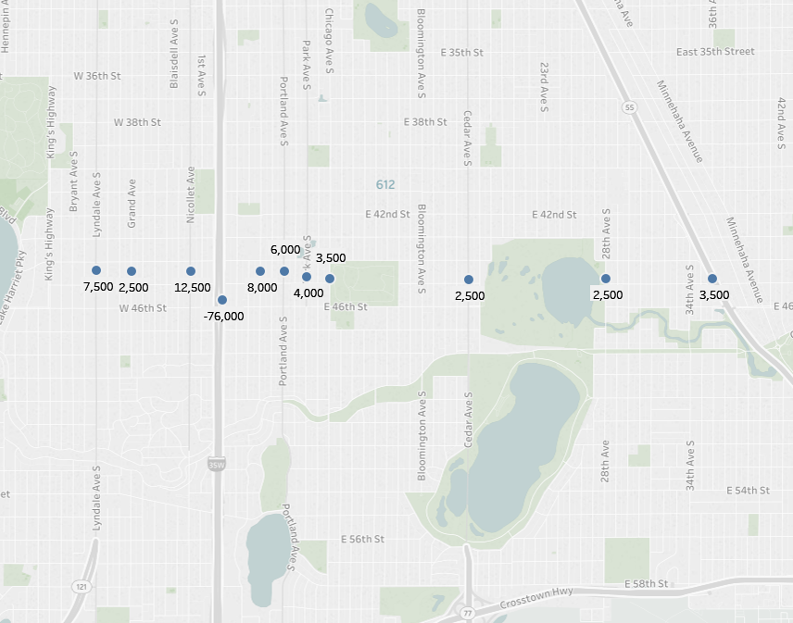
Volume Delta : Arterials
DTA
52,500 positive volume delta on arterials close to the work zone
Nearly 70% of diversion within 2.5 miles of I-35W
Volume Delta

Slide 16
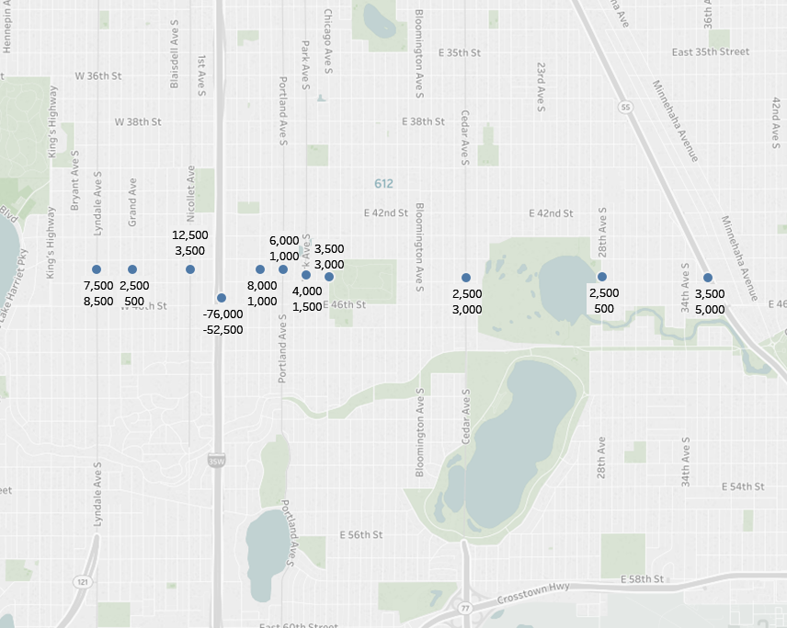
Arterials Volume Delta : ABM vs DTA
DTA
ABM
Traffic diversion similar on Lyndale Ave, Cedar Ave, Hiawatha
Low volume delta observed on Nicollet Ave
Concern that DTA model does not adequately constrain capacity on local roadways
DTA
ABM

Slide 17
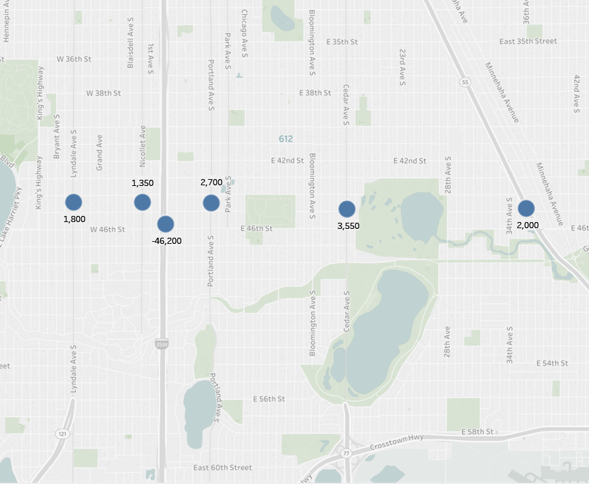
Streetlight Analysis : Arterial
Street
Light
No up-to-date volume data on arterials available
Streetlight O-D percentages were used to analyze traffic diversion on major parallel routes
Reported values estimated by applying proportion of volume diversion to StreetLight percentages

Slide 18
Summary: 35W Construction Scenario
DTA
Observation
DTA overestimates diversions to roadways closer to the work zone
Possible reasons
From previous analysis we know DTA directs more trips to local network
Recommendations
Additional customized “traffic flow models” could be developed for DTA
Addition of signal controls

Slide 19
US 169 Bridge Closure

Slide 20
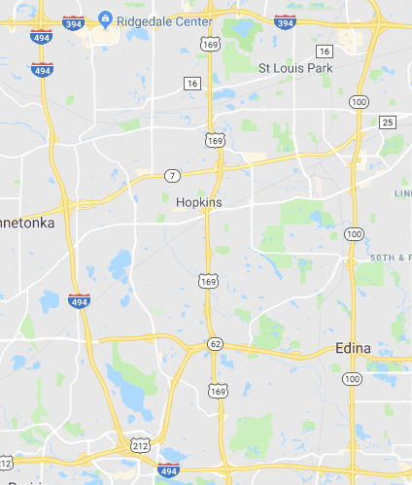
US 169 Bridge Closure
Bridge closed

Slide 21
Hwy 169 Construction Timeline
Initial traffic control configuration
Modified traffic control configuration
494 & 100 Constr.
Dovre Dr. Closure
Start
End
Nov 2016
Jan 2017
Mar 2017
Sep 2017
Data collection for pre-construction
Data collection for during construction

Slide 22
US 169: Construction Scenarios
Scenario | Description | Days of Construction
1a & 1b | Year 1: close one lane in each direction The freeway would remain open over the Nine Mile Creek bridge. Year 2: close one lane in each direction There would also be additional construction along I-35W between I-94 and 43rd Street and along I-94 between Nicollet Avenue to Shingle Creek Boulevard. | 335 + 215
2 | Close one lane of traffic in each direction Full closure over the Ninemile Creek bridge. | 335
3a & 3b | Directional closure of US 169 Year 1: Northbound full closure Year 2:Southbound full closure | 550
Scenario 2 most closely resembles the actual construction condition

Slide 23
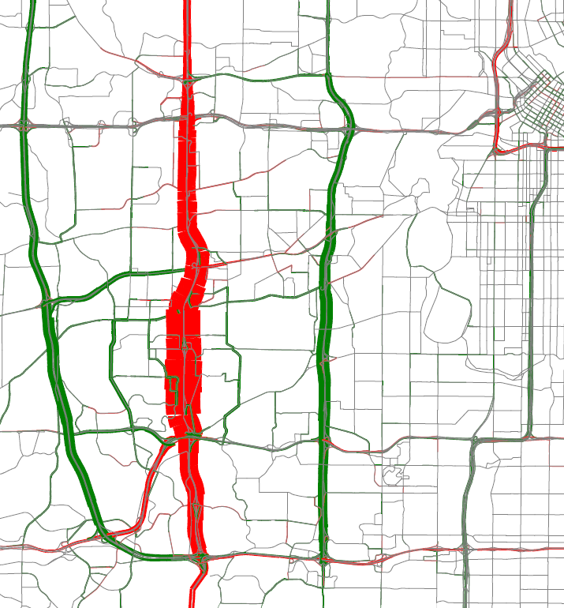
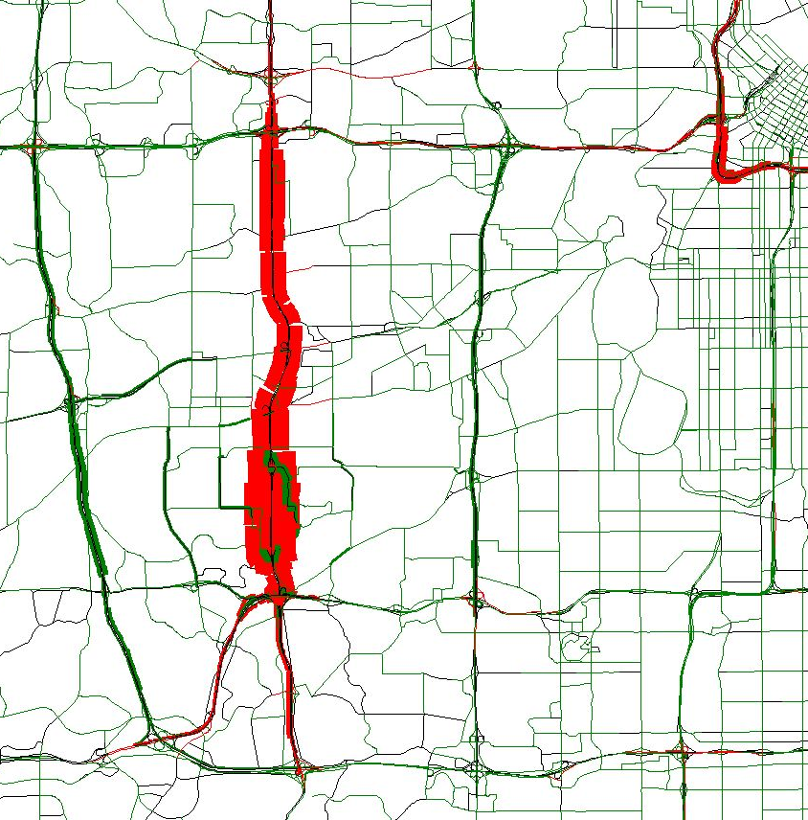
US 169 Construction Results
ABM
DTA

Slide 24
StreetLight Data
Street
Light
Assumptions for evaluation of Hwy 169 construction project
Pre-construction time period: Mid November – Mid December 2016 (excluding the Thanksgiving weekend)
Construction time period: April 2017
Data only showing personal vehicles indexed volume*
The volume is for average weekday and the time period is entire day
* Indexed volume does not indicate actual number of trips or vehicles on the road but can be used to understand travel patterns and percentages

Slide 25
Pre-construction NB Volume Using the Bridge
Street
Light
NB: 50,000
Middle Filter
Origin/Destination Passthrough Zone

Slide 26
Pre-construction NB Volume Using the Bridge
Street
Light
50% of NB traffic comes from 62 & 212 & Bren Rd
Middle Filter
Origin/Destination Passthrough Zone
50% of NB traffic comes from 169 S of 62

Slide 27
Pre-construction NB Volume Using the Bridge
Street
Light
Middle Filter
Origin/Destination Passthrough Zone
23% of NB traffic comes from 494 & Valley View
27% of NB traffic comes from 169 S of 494

Slide 28
Pre-construction SB Volume Using the Bridge
Street
Light
SB: 43,000
Middle Filter
Origin/Destination Passthrough Zone

Slide 29
Pre-construction SB Volume Using the Bridge
Street
Light
40% of SB traffic comes from 169 N of 394
60% of SB traffic comes from 394, Hwy 7, Excelsior Blvd, 7th St, etc.
Middle Filter
Origin/Destination Passthrough Zone

Slide 30
Traffic Diversions During Construction
32% of traffic originally using the bridge to/from TH 169 south of I-494 diverted to TH 100.
35% of traffic originally using the bridge to/from TH 169 south of I-494 diverted to I-494.
Middle Filter
Origin/Destination Passthrough Zone
Accounted Diversion Routes
Other Diversion Routes

Slide 31
Summary of US 169 Evaluation
DTA
Observation
DTA emphasizes diversions to roadways closer to the work zone area
Possible reasons and Recommendations
Signal controls are missing
More calibration is needed for DTA
Traffic flow models on freeways
Addition of signal controls
Use of other methods in DTA
Defining different user classes
Defining official detour routes
Add some ABM findings

Slide 32
Findings & Recommendations
DTA model tends to divert traffic later in the trip as it gets closer to the work zone, resulting in higher diversion to immediately adjacent routes
ABM (static assignment) may require more severe speed/capacity reductions on work zone links to replicate diversion magnitude
Signal control in DTA could help to constrain traffic shifts to local arterials

Slide 33
Thank you! Questions?
Minnesota Department of Transportation SRF Consulting Group, Inc.
Jim Henricksen, AICP Paul Morris, PE
Director of Travel Behavior Principal – Transportation Analytics
jim.Henricksen@state.mn.us pmorris@srfconsulting.com
651-234-7782 763-452-4773

